Slide 1

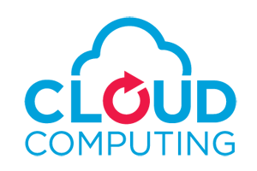
Chapter 1
Introduction

Slide 2
Cloud Computing Definition
Cloud computing is a model for enabling convenient, on-demand network access to a shared pool of configurable computing resources (e.g., networks, servers, storage, applications, and services) that can be rapidly provisioned and released with minimal management effort or service provider interaction.
This cloud model promotes availability and is composed of
Five essential characteristics,
Three service models, and
Four deployment models.

Slide 3
Essential Characteristics:
On-demand self-service. A consumer can unilaterally provision computing capabilities, such as server time and network storage, as needed automatically without requiring human interaction with each service’s provider.
Broad network access. Capabilities are available over the network and accessed through standard mechanisms that promote use by heterogeneous thin or thick client platforms (e.g., mobile phones, laptops, and PDAs).
Resource pooling. The provider’s computing resources are pooled to serve multiple consumers using a multi-tenant model, with different physical and virtual resources dynamically assigned and reassigned according to consumer demand. There is a sense of location independence in that the customer generally has no control or knowledge over the exact location of the provided resources but may be able to specify location at a higher level of abstraction (e.g., country, state, or datacenter). Examples of resources include storage, processing, memory, network bandwidth, and virtual machines.

Slide 4
Essential Characteristics:
Rapid elasticity. Capabilities can be rapidly and elastically provisioned, in some cases automatically, to quickly scale out and rapidly released to quickly scale in. To the consumer, the capabilities available for provisioning often appear to be unlimited and can be purchased in any quantity at any time.
Measured Service. Cloud systems automatically control and optimize resource use by leveraging a metering capability at some level of abstraction appropriate to the type of service (e.g., storage, processing, bandwidth, and active user accounts). Resource usage can be monitored, controlled, and reported providing transparency for both the provider and consumer of the utilized service.

Slide 5
The Pros and Cons of Cloud Computing
Pros of cloud computing:
No cost on infrastructure
Minimum management and cost (Cost Saving)
Forget about administrative or management hassles
Accessibility and pay per use
Reliability
Cons of cloud computing:
Requires good speed internet with good bandwidth
Limited control on infrastructure
Restricted or limited flexibility
Ongoing costs
Security

Slide 6
Cloud Service Models
Cloud Software as a Service (SaaS).
The capability provided to the consumer is to use the provider’s applications running on a cloud infrastructure. The applications are accessible from various client devices through a thin client interface such as a web browser (e.g., web-based email). The consumer does not manage or control the underlying cloud infrastructure including network, servers, operating systems, storage, or even individual application capabilities, with the possible exception of limited user-specific application configuration settings
Cloud Platform as a Service (PaaS).
The capability provided to the consumer is to deploy onto the cloud infrastructure consumer-created or acquired applications created using programming languages and tools supported by the provider. The consumer does not manage or control the underlying cloud infrastructure including network, servers, operating systems, or storage, but has control over the deployed applications and possibly application hosting environment configurations.

Slide 7
Cloud Service Models
Cloud Infrastructure as a Service (IaaS).
The capability provided to the consumer is to provision processing, storage, networks, and other fundamental computing resources where the consumer is able to deploy and run arbitrary software, which can include operating systems and applications. The consumer does not manage or control the underlying cloud infrastructure but has control over operating systems, storage, deployed applications, and possibly limited control of select networking components (e.g., host firewalls).

Slide 8
Deployment Models (Cloud Types)
Private cloud.
The cloud infrastructure is operated solely for an organization. It may be managed by the organization or a third party and may exist on premise or off premise.
Public cloud.
The cloud infrastructure is made available to the general public or a large industry group and is owned by an organization selling cloud services.
Hybrid cloud.
The cloud infrastructure is a composition of two or more clouds (private, community, or public) that remain unique entities but are bound together by standardized or proprietary technology that enables data and application portability (e.g., cloud bursting for load-balancing between clouds).
Community cloud.
The cloud infrastructure is shared by several organizations and supports a specific community that has shared concerns (e.g., mission, security requirements, policy, and compliance considerations). It may be managed by the organizations or a third party and may exist on premise or off premise.

Slide 9
Deployment Models (Cloud Types)
Private cloud.
The cloud infrastructure is operated solely for an organization. It may be managed by the organization or a third party and may exist on premise or off premise.
Public cloud.
The cloud infrastructure is made available to the general public or a large industry group and is owned by an organization selling cloud services.
Hybrid cloud.
The cloud infrastructure is a composition of two or more clouds (private, community, or public) that remain unique entities but are bound together by standardized or proprietary technology that enables data and application portability (e.g., cloud bursting for load-balancing between clouds).
Community cloud.
The cloud infrastructure is shared by several organizations and supports a specific community that has shared concerns (e.g., mission, security requirements, policy, and compliance considerations). It may be managed by the organizations or a third party and may exist on premise or off premise.

Slide 10
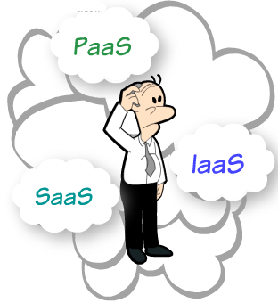

Slide 11



Comparison of SAAS PASS IAAS
SaaS
PaaS
IaaS
End-user Utilization
Software Development
System Architecture

Slide 12
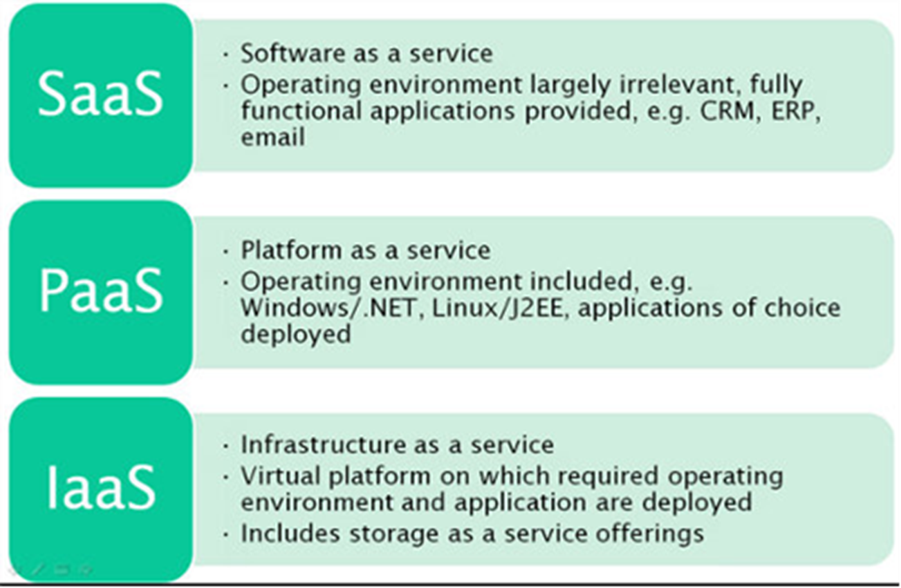
Comparison of SAAS PASS IAAS

Slide 13
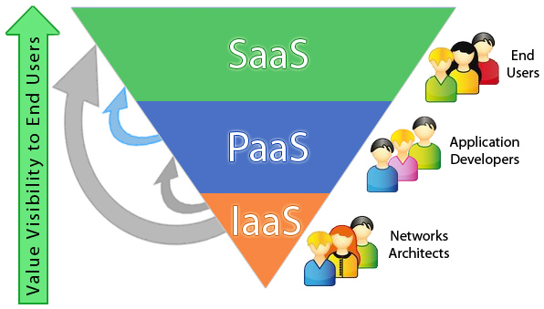

Slide 14
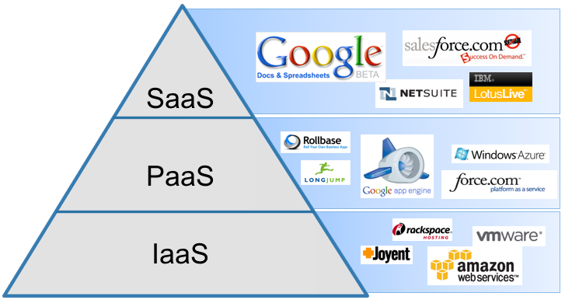
Example of vendors

Slide 15
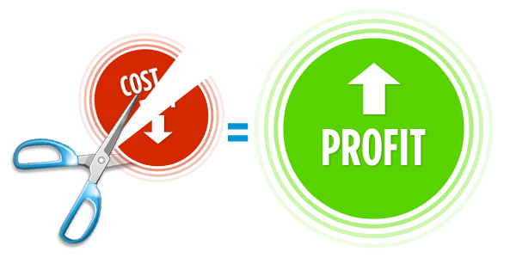



Benefits of CC
Global Infrastructure Savings
Smart Resource Provisioning
Better Delivery Time
Transparent Workflow
15

Slide 16

Thank You

